Slide 1
Chapter 14: Transactions

Slide 2
Chapter 14: Transactions
Transaction Concept
Transaction State
Concurrent Executions
Serializability
Recoverability
Implementation of Isolation
Transaction Definition in SQL
Testing for Serializability.

Slide 3
14.1 Transaction
The two core concepts in the design of DBMSs DBMS的两核心概念
  The data model that supports data abstraction. 数据模型 支持数据抽象（程序数据的独立性）
  The notion of transaction is the second core concept; it supports reliability and efficiency. 事务 支持DBMS的可靠性和高效
    Reliability
      Enforcing integrity constraints 完整性约束
      Ensuring data consistency despite hardware or software failures 数据一致性
    Efficiency
      Minimize data redundancy 减少冗余
      Enhance the performance of queries 提高查询性能
      Allowing multiple users to access the database concurrently 并发存取

Slide 4
Transaction Concept
E.g. transaction to transfer $50 from account A to account B:
  1. read(A)
  2. A := A – 50
  3. write(A)
  4. read(B)
  5. B := B + 50
  6. write(B)
Two main issues to deal with:
  Failures of various kinds, such as hardware failures and system crashes
  Concurrent execution of multiple transactions

Slide 5
Transaction basics -- definition
A transaction is a unit of program execution that accesses and possibly updates various data items.（ . 对数据库的一个完整操作序列）
Can be defined as
  A set of SQL statements
  Stored procedures
  Initiated by high level programming languages (Java, C++ etc.)
Delimited by begin transaction & end transaction
Example:
  Begin transaction
  X = select salary from instructor where name = “Kim”
  update instructor set salary = x * 10 where name = “Kim”
  Update instructor set salary = x / 10 where name = “Jose”
  End transaction

Slide 6
Example of Fund Transfer
Transaction to transfer $50 from account A to account B:
  1. read(A)
  2. A := A – 50
  3. write(A)
  4. read(B)
  5. B := B + 50
  6. write(B)
Atomicity requirement
  if the transaction fails after step 3 and before step 6, money will be “lost” leading to an inconsistent database state
    Failure could be due to software or hardware
  the system should ensure that updates of a partially executed transaction are not reflected in the database
Durability requirement — once the user has been notified that the transaction has completed (i.e., the transfer of the $50 has taken place), the updates to the database by the transaction must persist even if there are software or hardware failures.

Slide 7
Example of Fund Transfer (Cont.)
Transaction to transfer $50 from account A to account B:
  1. read(A)
  2. A := A – 50
  3. write(A)
  4. read(B)
  5. B := B + 50
  6. write(B)
Consistency requirement in above example:
  the sum of A and B is unchanged by the execution of the transaction
In general, consistency requirements include
    Explicitly specified integrity constraints such as primary keys and foreign keys
    Implicit integrity constraints
      e.g. sum of balances of all accounts, minus sum of loan amounts must equal value of cash-in-hand
  A transaction must see a consistent database.
  During transaction execution the database may be temporarily inconsistent.
  When the transaction completes successfully the database must be consistent
    Erroneous transaction logic can lead to inconsistency

Slide 8
Example of Fund Transfer (Cont.)
Isolation requirement — if between steps 3 and 6, another transaction T2 is allowed to access the partially updated database, it will see an inconsistent database (the sum A + B will be less than it should be).
T1 T2
  1. read(A)
  2. A := A – 50
  3. write(A)
  read(A), read(B), print(A+B)
  4. read(B)
  5. B := B + 50
  6. write(B)
Isolation can be ensured trivially by running transactions serially
  that is, one after the other.
However, executing multiple transactions concurrently has significant benefits, as we will see later.

Slide 9
ACID Properties
A transaction is a unit of program execution that accesses and possibly updates various data items.To preserve the integrity of data the database system must ensure:
Atomicity. Either all operations of the transaction are properly reflected in the database or none are.
  /*事务中所有操作或者全部成功完成，并且这些操作结果 被写入到DB；或者事务中的所有操作一个都不作, 该事务对数据库和其他事务没有任何影响
  /*将事务所有操作作为1个不可分割的整体
Consistency. Execution of a transaction in isolation preserves the consistency of the database.
    /*1个事务的正确执行使得DB从一个正确状态转移到另一个正确状态

Slide 10
ACID Properties
Isolation. Although multiple transactions may execute concurrently, each transaction must be unaware of other concurrently executing transactions. Intermediate transaction results must be hidden from other concurrently executed transactions.
  That is, for every pair of transactions T_{i} and T_{j}, it appears to T_{i} that either T_{j}, finished execution before T_{i} started, or T_{j} started execution after T_{i} finished.
  /*对多个并发执行的事务，1个事务的执行不能被其他事务干扰，即1个事物的内部操作和数据对其它事务是隔离的，并发执行的事务间不能相互干扰，从执行结果来看，相当于事务串行执行
Durability. After a transaction completes successfully, the changes it has made to the database persist, even if there are system failures.
  /*事务一旦提交（成功完成），它对数据库中数据的改变就应该是永久性的，这些改变不随其后的数据库系统错误而丢失

Slide 11
ACID Properties
To preserve the integrity of data the database system must ensure:
Atomicity.
  All or Nothing.
  Recovery sub-system
Consistency.
  correctness of the data-implicit and explicit
  Concurrency control and recovery
Isolation.
  Transactions must appear to be the only transaction that occurred
  Concurrency control sub-system
Durability
  The effect of the transaction must never be lost
  Recovery sub-system

Slide 12
Transaction State
Active – the initial state; the transaction stays in this state while it is executing
Partially committed – after the final statement has been executed.
Failed -- after the discovery that normal execution can no longer proceed.
Aborted – after the transaction has been rolled back and the database restored to its state prior to the start of the transaction. Two options after it has been aborted:
  restart the transaction
    can be done only if no internal logical error
  kill the transaction
Committed – after successful completion.

Slide 13

Transaction State (Cont.)
commit
rollback

Slide 14
Transaction States (cont.)
Active
  the initial state, the transaction stays in this state while it is executing from begin-transaction
  in this state, the transaction is created (after begin-transaction is submitted), resources, e.g. local buffer are allocated to the transaction
Note
  transaction operations are executed, but the modifications on DB issued by operations may only stored temporally in the disk buffer, not reflected to DB file on disks immediately

Slide 15
Transaction States (cont.)
Partially committed (部分提交) :
  after the final statement (i.e. Commit ) has been submitted, the transaction enters this state
  in this state, the influences that the transaction’s operations have made on DB are reflected from the disk buffer to DB by DBMS
  /*DBMS将disk缓冲区中的DB修改结果写入磁盘DB文件中

Slide 16
Transaction States (cont.)
Aborted (夭折/异常结束/中止状态)
  after the transaction has been rolled back in failed state, and the DB has been restored to its state prior to the start of the transactions, it enters this state to end the transaction
  /*表示DBMS已完成失败处理工作, 事务将要退出系统
  in this state, the transaction
    releases the resources occupied
    reports to its user that the transaction is aborted
    and then terminated (quits DBS)
    , the cycle-life of the transaction is ended
  e.g. Fig.15.0.6

Slide 17
Transaction States (cont.)
Committed
  after the transaction has successfully completed all its operations, and all the results of these operations have been reflected to the DB in partial commit state, it enters this state
  in this state, the transaction
    releases the resources occupied
    and then terminated (quits DBS),
    the cycle-life of the transaction is ended .

Slide 18
Transaction States (cont.)
Failed
  if it is discovered that normal execution can no longer proceed, the transaction enters this state
  in this state, the transaction is rolled back to restore DB to the state prior to the start of the transactions (§17)
  /*在此状态下进行失败处理工作
  e.g. Fig.15.0.6

Slide 19
Transaction States (cont.)
begin-trans.
op₁;
op_{i};
…
op_{j};
op_{n};
commit.
e.g.
select
e.g. insert,
update
DBMS
allocate
resources,
e.g. local buffer;
create and start trans.
reflect data
to disk
release
Resources;
end trans.
local
-buff.
x, y
disk
-buff.
disk
partially
commit
states:
active
commit
Fig.15.0.5 Life-cycle of a successful/committed transaction

Slide 20
Transaction States (cont.)
begin-trans.
op₁;
op_{i};
…
op_{j};
op_{n};
rollback
e.g.
select
e.g. insert,
update
DBMS
allocate
resources,
e.g. local buffer;
create and start trans.
rollback
(undo or redo)
the previous
operations
release
resources;
end trans.
local
-buff.
disk
-buff.
restore
Disk
states:
active
failed
aborted
Fig.15.0.6 Life-cycle of a rollback transaction

Slide 21
An Example of Roll Back in Transaction
Roll back (回滚、滚回)
  撤销到目前为止事务已经对数据库做的所有修改，使数据库状态恢复到事务开始前的状态
E.g. define table SC as
create table SC
(s# integer,
c# integer,
grade integer,
check (grade between 0 AND 100 )
)
define the update transaction update-tran as:
update SC
set grade = grade + 5
where ….

Slide 22
restore/rollback the
tuples updated
update on some tuples
s# | c# | grade
101 | 1 | 85
102 | 2 | 55
201 | 2 | 75
210 | 5 | 100
401 | 3 | 77
… | … | …
510 | 2 | 60
s# | c# | grade
101 | 1 | 90
102 | 2 | 60
201 | 2 | 80
210 | 5 | 105
401 | 3 | 77
… | … | …
510 | 2 | 60
s# | c# | grade
101 | 1 | 85
102 | 2 | 55
201 | 2 | 75
210 | 5 | 100
401 | 3 | 77
… | … | …
510 | 2 | 60
(a) the initial
SC instance
(b) SC instance when failure occurs during execution of transaction, i.e. integrity is violated
(c) SC instance after roll back, i.e. canceling all the updates on SC having been made, equal to the initial instance

Slide 23
An Example of Roll Back in Transaction (cont.)
When tuple 1, 2, 3 have been successfully updated and tuple 4 is updated, the values of t4[grade]=105 >100, the integrity is violated
DBMS rollbacks the transaction update-tran
  restore the values of t1[grade], t2[grade], t3[grade] and t4[grade] to its initial values

Slide 24
Concurrent Executions
Multiple transactions are allowed to run concurrently in the system. Advantages are:
  increased processor and disk utilization, leading to better transaction throughput
    E.g. one transaction can be using the CPU while another is reading from or writing to the disk
  reduced average response time for transactions: short transactions need not wait behind long ones.
Concurrency control schemes – mechanisms to achieve isolation
  that is, to control the interaction among the concurrent transactions in order to prevent them from destroying the consistency of the database
    Will study in Chapter 16, after studying notion of correctness of concurrent executions.

Slide 25
Concurrent Executions (cont.)
With respect to a set of transactions, a schedule on this set is
  the execution sequences that indicate the chronological order in which instructions/operations of concurrent transactions are executed
  arranged by DBMS’ concurrency-control component
  note:
    a schedule for a set of transactions must consist of all instructions of those transactions
    must preserve the order in which the instructions appear in each individual transaction.

Slide 26
Read and Write Operations
Each data access in transactions, such as select, Update in SQL, or API in ODBC, is translated/decomposed by DBMS into one or more read and write operations
Refer to Fig. (Next slide)
DBMS executes these read and write operations to fulfill data access in transactions
For each transaction, DBMS allocates a local buffer in main memory as the working area for this transaction
The database permanently resides on disk, but some portion of it is temporarily residing in the disk buffer in main memory

Slide 27
Schedules
Schedule – a sequences of instructions that specify the chronological order in which instructions of concurrent transactions are executed
  a schedule for a set of transactions must consist of all instructions of those transactions
  must preserve the order in which the instructions appear in each individual transaction.
A transaction that successfully completes its execution will have a commit instructions as the last statement
  by default transaction assumed to execute commit instruction as its last step
A transaction that fails to successfully complete its execution will have an abort instruction as the last statement

Slide 28

Schedule 1
Let T₁ transfer $50 from A to , and T₂ transfer 10% of the balance from A to B.
A serial schedule in which T₁ is followed by T₂ :
A (1000) ,B(2000) =>A(855), B(2145)

Slide 29

Schedule 2
A serial schedule where T₂ is followed by T₁
A (1000) ,B(2000) =>A(850), B(2150)

Slide 30

Schedule 3
Let T₁ and T₂ be the transactions defined previously. The following schedule is not a serial schedule, but it is equivalent to Schedule 1.
并发调度将针对A的2次写操作、针对B的2次写操作安排在相近时间执行，利于DBMS在checkpoint时刻一次性地将A、B的修改结果写回数据库文件，减少DB file的写/output操作次数；
类似地，将针对A的2次读操作、针对B的2次读操作安排在相近时间执行，有利于减少对DB file 的读/input操作次数
In Schedules 1, 2 and 3, the sum A + B is preserved.

Slide 31

Schedule 4
The following concurrent schedule does not preserve the value of (A + B ).
A (1000) ,B(2000) =>A(950), B(2150)
A=1000

Slide 32
Schedule 3,4
Why S3 is right
  in S3, T1 and T2 access shared data A and B serially
  with respect to shared data A and B, S3 has the same executing results as serial S1, and S3 is equivalent to serial S1
Why S4 is wrong
  T1 and T2 operate on shared data A and B in interweaving (交错, 交织) ways
  S4 has not the same executing results as serial S1, and S4 is not equivalent to serial S1;
  S4 leaves the database in an inconsistent state, and isolation and consistency are violated

Slide 33
Serializability
Basic Assumption – Each transaction preserves database consistency.
Thus serial execution of a set of transactions preserves database consistency.
A (possibly concurrent) schedule is serializable if it is equivalent to a serial schedule. Different forms of schedule equivalence give rise to the notions of:
  1. conflict serializability
  2. view serializability

Slide 34
Simplified view of transactions
  We ignore operations other than read and write instructions
  We assume that transactions may perform arbitrary computations on data in local buffers in between reads and writes.
  Our simplified schedules consist of only read and write instructions.

Slide 35
Conflicting Instructions
Instructions l_{i} and l_{j} of transactions T_{i} and T_{j} respectively, conflict if and only if there exists some item Q accessed by both l_{i} and l_{j}, and at least one of these instructions wrote Q.
1. l_{i} = read(Q), l_{j} = read(Q). l_{i} and l_{j} don’t conflict.
2. l_{i} = read(Q), l_{j} = write(Q). They conflict.
3. l_{i} = write(Q), l_{j} = read(Q). They conflict
4. l_{i} = write(Q), l_{j} = write(Q). They conflict
Intuitively, a conflict between l_{i} and l_{j} forces a (logical) temporal order between them.
  If l_{i} and l_{j} are consecutive(连续） in a schedule and they do not conflict, their results would remain the same even if they had been interchanged in the schedule.

Slide 36
Conflict Serializability
If a schedule S can be transformed into a schedule S´ by a series of swaps of non-conflicting instructions, we say that S and S´ are conflict equivalent.（如果调度S只交换一对非冲突指令的次序，就变成调度S´，则二者称为 冲突等价 conflict equivalent.）
We say that a schedule S is conflict serializable if it is conflict equivalent to a serial schedule（如调度冲突等价于串行调度，则称为 conflict serializable）

Slide 37


Conflict Serializability (Cont.)
  if the schedule S can be transformed into S’ by a series of swaps of non-conflicting instructions,then S and S’ are conflict equivalent
Schedule 3 can be transformed into Schedule 6, a serial schedule where T₂ follows T₁, by series of swaps of non-conflicting instructions. Therefore Schedule 3 is conflict serializable.
Schedule 3
Schedule 6

Slide 38
Conflict Serializability (cont.)
Note:
  only swapping of two operations/instructions I_{i} and I_{j} that belong to two different T_{i} and T_{j} respectively are permitted
  swapping should not change the orders of instruction executing in each transaction
    e.g. in Schedule 3, swapping of read(B) and write(B) in T₁ is not allowed
  swapping should not change the orders of conflict instruction executing in S
    e.g. in Schedule 3, swapping of write(A) in T₁ and read(A) in T₂ is not allowed

Slide 39

Conflict Serializability (Cont.)
Example of a schedule that is not conflict serializable:
We are unable to swap instructions in the above schedule to obtain either the serial schedule < T₃, T₄ >, or the serial schedule < T₄, T₃ >.

Slide 40

Conflict Seriazability（cont)
冲突：I_{i}和I_{j}是不同事务在相同的数据项上的操作，并且其中至少有一个write指令时，I_{i}和I_{j}是冲突的
红色 ==冲突
绿色==不冲突
T1的write(A)和T2的read(A)冲突
T2 的write(A)和T1的read(B)不冲突
可以交换次序

Slide 41
Identification of Conflict Serializability
Given a concurrent schedule S, how to determine whether or not S is conflict serializable (i.e. is right) ?
Method 1
  starting from the concurrent S, maintaining executing orders of conflicting operations in S, and swapping executing orders of non-conflicting operations in S
  observing whether or not a serial S’ can be obtained
Method 2
  precedence-graph

Slide 42
Identification of Conflict Serializability
-An Example
Given the following concurrent schedule S on transactions T1, T2, T3, and T4
  determine whether or not S is conflict-serializable ?
  if S is conflict-serializable, give its equivalent serial schedule; and if it is not, give the reason

Slide 43
Identification of Conflict Serializability
-An Example (cont.)
Time T1 T2 T3 T4
1 read(X)
2 write(X)
3 write(Y)
4 read(Y)
5 read(Y)
6 read(X)
7 write(Z)
8 write(X)
Fig.15.0.10
Answer: S is equivalent to <T3; T2; T4; T1>

Slide 44
Testing for Serializability
- Precedence-graph
Def. Given a schedule S of a set of transactions T₁, T₂, ..., T_{n} , the precedence graph (前趋图) G(S) for S is
  a direct graph G(V, E) where the vertices are the transactions
  an arc from T_{i} → T_{j} , for which one of three conditions holds
    T_{i} executes write(Q) before T_{j} executes read(Q),
    T_{i} executes read(Q) before T_{j} executes write(Q)
    T_{i} executes write(Q) before T_{j} executes write(Q)

Slide 45
Testing for Serializability
- Precedence-graph (cont.)
T_{i} T_{j}
T_{i} T_{j}
T_{i} T_{j}
.
.
.
read(Q)
.
.
.
.
.
write(Q)
.
.
.
.
.
write(Q)
.
.
write(Q)
.
.
.
.
read(Q)
.
.
.
.
write(Q)
.
.
.
.
.
(a)
(b)
(c)
t
Fig. Cases for arc T_{i} → T_{j} in precedence graphs

Slide 46
Precedence graph for S
Testing for Serializability
- Precedence-graph (cont.)
A schedule is conflict serializable if and only if its precedence graph is acyclic
E.g. Concurrent schedule S and its precedence graph in Fig.15.0.12 in the next slide
T₁
T₂
T₅
T₄
T₃

Slide 47
Fig.15.0.12 Concurrent schedule S
T₁ T₂ T₃ T₄ T₅
read(X)
read(Y)
read(Z)
read(V)
read(W)
read(W)
read(Y)
write(Y)
write(Z)
read(U)
read(Y)
write(Y)
read(Z)
write(Z)
read(U)
write(U)
Precedence graph for S
T₁
T₂
T₄
T₃
T₅
T1,T2,T4,T3,T5

Slide 48
Construction of Conflict Serializable Concurrent Schedule
Given a serial schedule S, how to construct a concurrent S’, which is conflict equivalent to S
  starting from schedule S, maintaining executing orders of conflicting operations in S, and swapping executing orders of non-conflicting operations in S, resulting in a conflict serializable S’
  e.g. serial schedule S6 in Fig.15.9 and concurrent S5 in Fig.15.8

Slide 49

Testing for Serializability
Consider some schedule of a set of transactions T₁, T₂, ..., T_{n}
Precedence graph — a direct graph where the vertices are the transactions (names).
We draw an arc from T_{i} to T_{j} if the two transaction conflict, and T_{i} accessed the data item on which the conflict arose earlier.
We may label the arc by the item that was accessed.
Example 1

Slide 50

Test for Conflict Serializability
A schedule is conflict serializable if and only if its precedence graph is acyclic.
Cycle-detection algorithms exist which take order n² time, where n is the number of vertices in the graph.
  (Better algorithms take order n + e where e is the number of edges.)
If precedence graph is acyclic, the serializability order can be obtained by a topological sorting of the graph.
  This is a linear order consistent with the partial order of the graph.
  For example, a serializability order for Schedule A would be
  T₅ → T₁ → T₃ → T₂ → T₄
    Are there others?

Slide 51
§14.6 Recoverability
Recoverability address how to deal with the schedules when transaction failures occur
Requirements
  when transaction T_{i} fails, the operations already executed should be rollbacked/undone/aborted/canceled to ensure the atomicity
  when transaction T_{i} fails, any T_{j} that is dependent on T_{i} should also be aborted ,
    e.g. T_{j} reads data having been written by T_{i}
    计算全班平均成绩 修改个人成绩

Slide 52
14.6 Recoverability (cont.)
A recoverable schedule is a schedule, where for each pair of T_{i} and T_{j}
  if T_{j} reads a data items previously written by T_{i} , the commit operation of T_{i} appears before the commit operation of T_{j}.
/*解释：
T_{j} 依赖于 T_{i}；当T_{i}中的write(Q)需要aborted/rollback时，由于T_{j}还没有提交，T_{j} 可以rollback, 因此T_{j}中的read(Q) 操作也随之aborted（ T_{j} 操作T_{i}已经提交的数据 ）
T_{i} T_{j}
write(Q)
.
.
read(Q)
.
.
commit
.
commit
Fig.14.0.18 Definition of recoverable schedule

Slide 53

Recoverable Schedules
Need to address the effect of transaction failures on concurrently running transactions.
Recoverable schedule — if a transaction T_{j} reads a data item previously written by a transaction T_{i} , then the commit operation of T_{i} appears before the commit operation of T_{j}.
The following schedule (Schedule 11) is not recoverable if T₉ commits immediately after the read
If T₈ should abort, T₉ would have read (and possibly shown to the user) an inconsistent database state. Hence, database must ensure that schedules are recoverable.
rollback

Slide 54

Cascading Rollbacks
Cascading rollback – a single transaction failure leads to a series of transaction rollbacks. Consider the following schedule where none of the transactions has yet committed (so the schedule is recoverable)
If T₁₀ fails, T₁₁ and T₁₂ must also be rolled back.
Can lead to the undoing of a significant amount of work
可能发生
瀑布式回退
如 T10 失败
, T11 T12 必须回退.
读了脏数据

Slide 55
Cascadeless Schedules
Cascadeless schedules — cascading rollbacks cannot occur; for each pair of transactions T_{i} and T_{j} such that T_{j} reads a data item previously written by T_{i}, the commit operation of T_{i} appears before the read operation of T_{j}.（对于事务T_{i}和T_{j},如果T_{j}读取了先前由T_{i}所写的数据项，则T_{i}必须在T_{j}这一读操作前提交）
Every cascadeless schedule is also recoverable
It is desirable to restrict the schedules to those that are cascadeless

Slide 56
Concurrency Control
A database must provide a mechanism that will ensure that all possible schedules are
  either conflict or view serializable, and
  are recoverable and preferably cascadeless
A policy in which only one transaction can execute at a time generates serial schedules, but provides a poor degree of concurrency
  Are serial schedules recoverable/cascadeless?
Testing a schedule for serializability after it has executed is a little too late!
Goal – to develop concurrency control protocols that will assure serializability.

Slide 57
Concurrency Control (Cont.)
Schedules must be conflict or view serializable, and recoverable, for the sake of database consistency, and preferably cascadeless.
A policy in which only one transaction can execute at a time generates serial schedules, but provides a poor degree of concurrency.
Concurrency-control schemes tradeoff between the amount of concurrency they allow and the amount of overhead that they incur.
Some schemes allow only conflict-serializable schedules to be generated, while others allow view-serializable schedules that are not conflict-serializable.

Slide 58
Concurrency Control vs. Serializability Tests
Concurrency-control protocols allow concurrent schedules, but ensure that the schedules are conflict/view serializable, and are recoverable and cascadeless .
Concurrency control protocols generally do not examine the precedence graph as it is being created
  Instead a protocol imposes a discipline that avoids nonseralizable schedules.
  We study such protocols in Chapter 16.
Different concurrency control protocols provide different tradeoffs between the amount of concurrency they allow and the amount of overhead that they incur.
Tests for serializability help us understand why a concurrency control protocol is correct.

Slide 59
Levels of Consistency in SQL-92
Serializable — default
Repeatable read — only committed records to be read, repeated reads of same record must return same value. However, a transaction may not be serializable – it may find some records inserted by a transaction but not find others.
Read committed — only committed records can be read, but successive reads of record may return different (but committed) values.
Read uncommitted — even uncommitted records may be read.
Lower degrees of consistency useful for gathering approximate
information about the database
Warning: some database systems do not ensure serializable schedules by default
  E.g. Oracle and PostgreSQL by default support a level of consistency called snapshot isolation (not part of the SQL standard)

Slide 60
Transaction Definition in SQL
Data manipulation language must include a construct for specifying the set of actions that comprise a transaction.
In SQL, a transaction begins implicitly.
A transaction in SQL ends by:
  Commit work commits current transaction and begins a new one.
  Rollback work causes current transaction to abort.
In almost all database systems, by default, every SQL statement also commits implicitly if it executes successfully
  Implicit commit can be turned off by a database directive
    E.g. in JDBC, connection.setAutoCommit(false);

Slide 61
End of Chapter 14

Slide 62
Figure 14.01

Slide 63
Figure 14.02

Slide 64
Figure 14.03

Slide 65
Figure 14.04

Slide 66
Figure 14.05

Slide 67
Figure 14.06

Slide 68
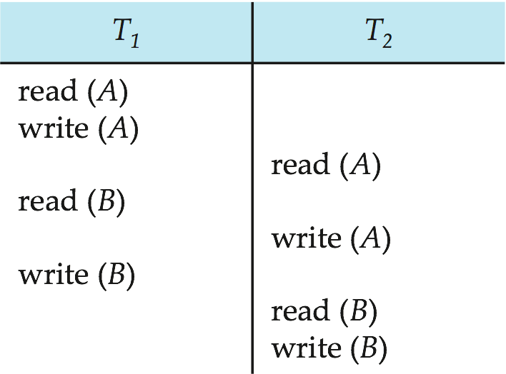
Figure 14.07

Slide 69
Figure 14.08

Slide 70
Figure 14.09

Slide 71
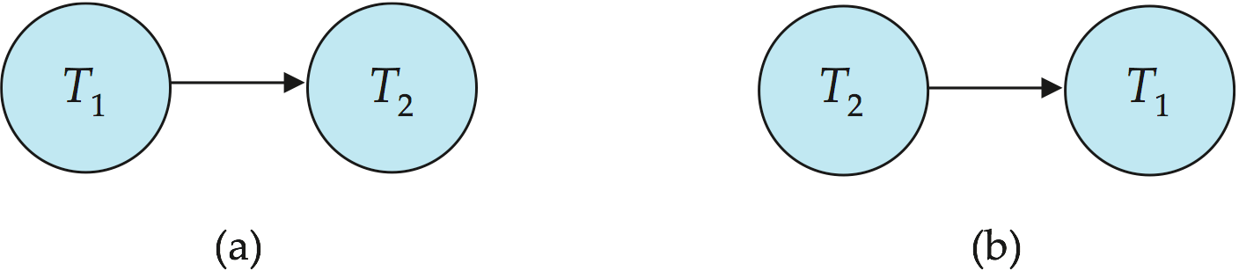
Figure 14.10

Slide 72
Figure 14.11

Slide 73
Figure 14.12

Slide 74

Figure 14.13

Slide 75
Figure 14.14

Slide 76
Figure 14.15

Slide 77
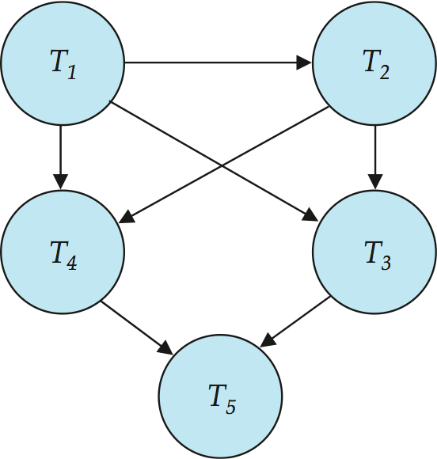
Figure 14.16

